Slide 1
Similes

Slide 2
Similes compare different things. They use the words “as” or “like” to compare by showing how two objects are the same.

Slide 3
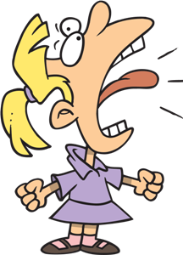
I can roar as loud as a tiger.

Slide 4
The moon shined like a diamond.

Slide 5
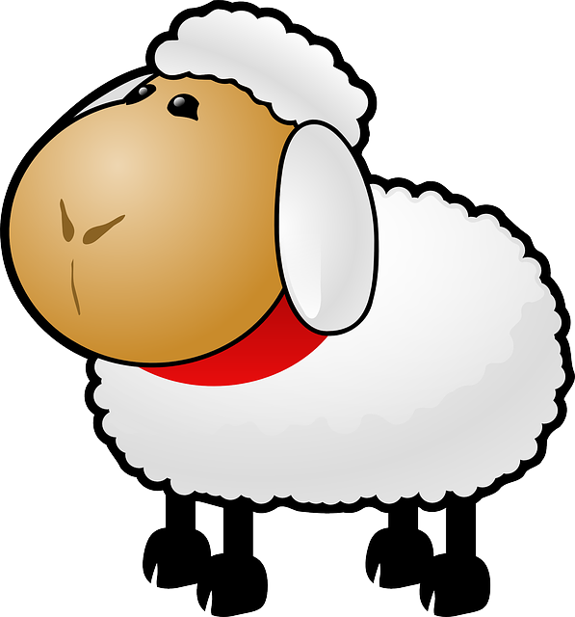
His pillow was as fluffy as lambs wool.

Slide 6
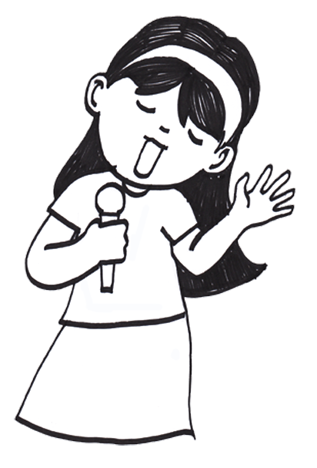
Sarah sings like an angel.

Slide 7
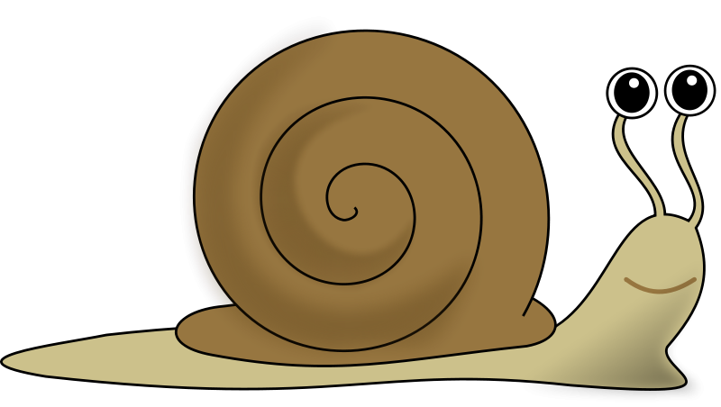
What is the simile in this sentence?
Timothy walked as slow as a snail.

Slide 8
What is the simile in this sentence?
Timothy walked as slow as a snail.

Slide 9
Complete the simile.
Jack’s drink was as cold as _______.

Slide 10
Complete the simile.
Jess ran home quickly like a _______.

Slide 11
Can you find the simile in this poem?

Slide 12
I’ve got a dog as thin as a rail, he’s got fleas all over his tail; Every time his tail goes flop, the fleas on the bottom all hop to the top.

Slide 13
I’ve got a dog as thin as a rail, he’s got fleas all over his tail; Every time his tail goes flop, the fleas on the bottom all hop to the top.

Slide 14
What two words do similes use?

Slide 15
“like” and “as”

