Slide 1
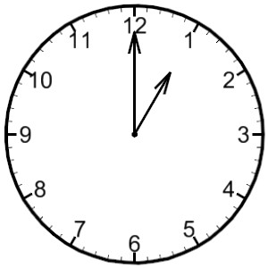
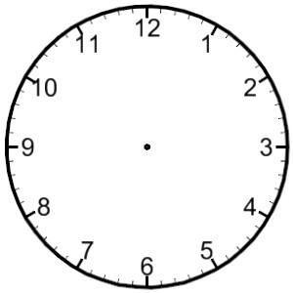
LO: read analogue and digital time (in 5 minutes)
Analogue time
Minnie Minute
Analogue Time
O’Clock
five minutes to
five minutes past
ten minutes to
ten minutes past
Minutes to
Minutes past
quarter to
quarter past
twenty minutes to
twenty minutes past
twenty five minutes to
twenty five minutes past
half past

Slide 2
Digital Time
00:05
00:20
00:35
00:10
00:15
00:25
00:30
00:50
00:00
00:40
00:45
00:55
Minnie Minute
O’Clock
fifty five minutes past
five minutes past
fifty minutes past
ten minutes past
forty five minutes past
fifteen minutes past
forty minutes past
twenty minutes past
thirty five minutes past
twenty five minutes past
thirty minutes past

