Slide 1
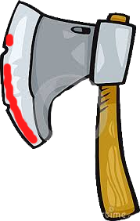
Instructions:
Are your young Viking raiders daring enough to play this tantalizing, animated Viking board game, where a correct answer can win you valuable treasures...or death !?
Squares can be attacked after correct answers to your own Viking quiz questions. But raiders beware: uncover two skulls and your team is…off to Valhalla!
(Fully customizable end slide).
NEXT

Slide 2
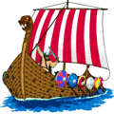
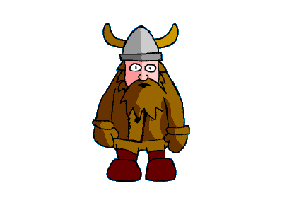
The peaceful English coast, 789 AD ...
Viking
Raiders

Slide 3
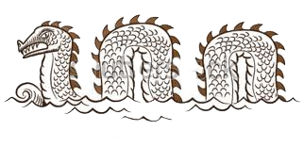
SCORING:
Atlantic
Ocean
Attack a
Square!
40 points
25 points
North Sea
10 points
-20 men
You start
with
40 men.
NEW
GAME
GAME 1
PLAY

Slide 4
SCORING:
Atlantic
Ocean
Attack a
Square!
40 points
25 points
North Sea
10 points
-20 men
You start
with
40 men.
NEW
GAME
GAME 2
PLAY

Slide 5
SCORING:
Atlantic
Ocean
Attack a
Square!
40 points
25 points
North Sea
10 points
-20 men
You start
with
40 men.
NEW
GAME
GAME X
PLAY
Notes:
YOU CAN EDIT THE GAME HERE. TO EDIT THE POSITIONS OF THE TREASURE: 1. EXCHANGE THEIR POSITIONS 2.SELECT (CLICK ON) ALL TREASURE ITEMS 3. R-Click MENU: ORDER TO BACK. OR WHY NOT REPLACE ITEMS WITH YOUR OWN ?

