Slide 1
Choose a building project.
Use your number bonds to build.
Receive tips and encouragement
(with real audio in PPT 2007 and above).
Complete the build…receive a surprise!
Check your builders' learning with a short test.
Choose another project!

Slide 3
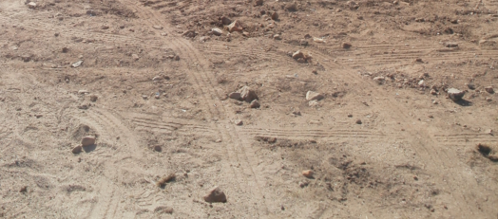
I need a crane
5 bricks wide.
Can you help me?
Click to choose 2 bricks below.

2 +
3
= 5

Slide 4
Choose again!
Great job!

1 +
4
2 +
3

= 5

Slide 5
Nice maths!
3 +
2


1 +
4
= 5

Slide 6
Well done!
1 +
4
3 +
2

= 5
2 +
3


Slide 7
Great Job!
5 +
0

1 +
4
= 5

2 +
3


Slide 8
Brilliant!
3 +
2
5 +
0

= 5

2 +
3

Slide 9
1 +
4
Fine work!
3 +
2

= 5
2 +
3


Slide 10

Nice maths!
1 +
4
= 5
Job Done!

Slide 12
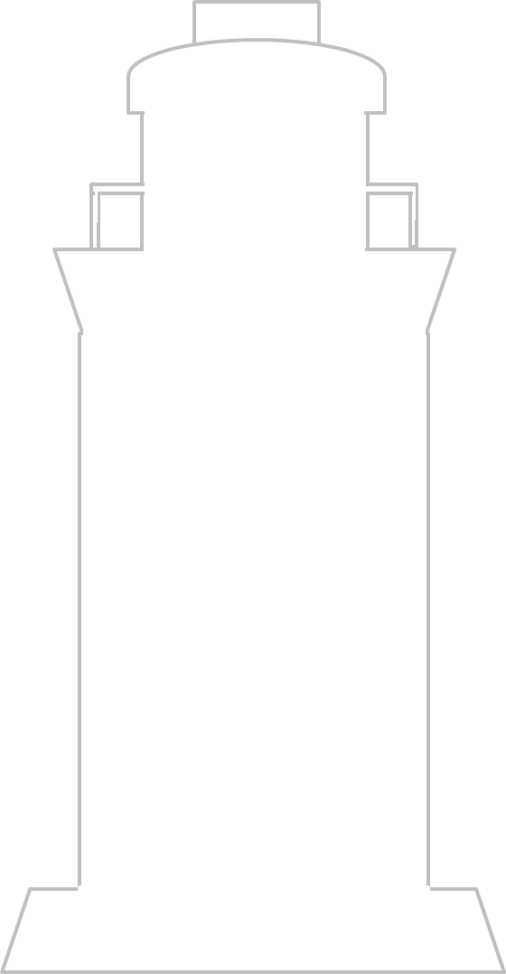
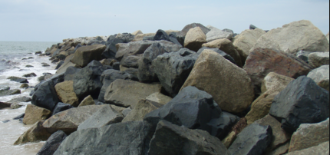
I need a lighthouse
6 bricks wide.
Can you help?
Click to choose 2 bricks below

3 +
3
= 6

Slide 13
Choose again!
Great job!
2 +
4

3 +
3

= 6

Slide 14
Nice maths!
3 +
3
2 +
4

= 6


Slide 15
Fine
work!
5 +
1
3 +
3

= 6


Slide 16
Well done!
4 +
2
5 +
1

= 6


Slide 17
Brilliant!
3 +
3

4 +
2
= 6


Slide 18
Super adding!
Is that
a ship ?
Job Done!
3 +
3

= 6
4 +
2

Slide 19
4 +
2

Slide 20
Wow!
That was close!
4 +
2

Slide 22
Test
Over!
Let’s begin!
5 +
0
= 5
4 + 1
= 5
1 +
4
= 5
2 + 3
= 5
3
+ 2
= 5

Slide 24
Test
Over!
Let’s begin!
6 +
0
= 6
5 + 1
= 6
1 +
5
= 6
3 + 3
= 6
4
+ 2
= 6

