Slide 1
Word Problems

Slide 2
Multiplication arrays
How can we easily solve 6x3?
6x3 is the same as saying:
“6 groups of 3”.
If we make the groups, we can easily find the answer.

Slide 3
Multiplication arrays
Let’s make those groups.
Remember, 6 groups of 3; write them on your whiteboards.

Slide 4
Multiplication arrays
If we rotate the array, is the answer still the same?
Yes!
6 groups of 3 is the same as having 3 groups of 6.
6x3=18
3x6=18

Slide 5
Division arrays
We can use the array to solve division.
18÷6=
1
2
3
4
5
6
7
8
9
10
11
12
13
14
15
16
17
18

Slide 6
Division arrays
18 divided into 6 groups makes 6 groups of 3.
18÷6=3
Think back to the multiplication sum. Can you see the link?
1
2
3
4
5
6
7
8
9
10
11
12
13
14
15
16
17
18

Slide 7
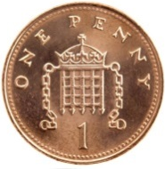
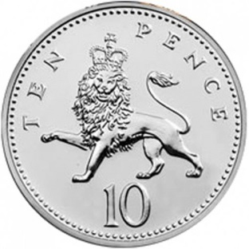
Division with remainders
Solve 65÷10
Make groups of 10 to start with.

Slide 8
We have 6 groups of 10.
How much is that in total?
6x10=60
60 65
+5
There are 5 left over

Slide 9
65÷10= 6r5

Slide 10
Word Problems
Read these word problems, what is the sum you need to do?
There are 35 cakes and 7 people at a party. How many cakes can each person eat?
There are 4 year groups in a school. Each year group has 3 teachers. How many teachers altogether?

