Slide 1
Pointless
Round 1
Round 2
Finish

Slide 2

Prime numbers
Rectangle dimensions
Units for area
Square numbers
Units for length
Multiples of 4
Factors of 96
Units for weight
Multiples of 3
Multiples of 13
Units for volume
Multiples of 15
Roman numerals
Measuring equipment
Factors of 144
Cube numbers
Number puzzle
Multiples of 0.6
Round 1 Choices

Slide 3
Angles and Shapes
Factors
Symmetry & 3D nets
Fractions, Decimals & %
Number Sequences
Money
Fractions & % calculations
Algebra
Place Value
Co-ordinates & Compass Points
Time
Rounding
Ratio & Proportion
Data Handling
Negative Numbers
Area, Perimeter & Volume
Puzzles
Roman Numerals
Round 2 Choices

Slide 4
We gave 100 people 100 seconds to name prime numbers 0-100.
Answers

Slide 5
Answer | Points
2 | 90
3 | 95
5 | 92
7 | 93
11 | 91
13 | 88
17 | 85
19 | 79
23 | 73
29 | 62
31 | 60
37 | 55
41 | 52
43 | 50
Answer | Points
47 | 48
53 | 46
59 | 44
61 | 43
67 | 41
71 | 40
73 | 36
79 | 34
83 | 28
89 | 25
97 | 19

Slide 6
We gave 100 people 100 seconds to name square numbers < 200.
Answers

Slide 7
Answer | Points
1 | 76
4 | 82
9 | 80
16 | 79
25 | 75
36 | 69
49 | 45
64 | 43
81 | 52
100 | 70
121 | 19
144 | 20
169 | 6
196 | 1

Slide 8
We gave 100 people 100 seconds to name a factor of 96.
Answers

Slide 9
Answer | Points
1 | 90
2 | 76
3 | 40
4 | 37
6 | 22
8 | 31
12 | 28
16 | 10
24 | 15
32 | 25
48 | 65
96 | 86

Slide 10
We gave 100 people 100 seconds to name a multiple of 13 (0-200).
Answers

Slide 11
Answer | Points
13 | 96
26 | 85
39 | 70
52 | 54
65 | 76
78 | 47
91 | 42
104 | 32
117 | 27
130 | 83
143 | 17
156 | 14
169 | 6
182 | 0
195 | 10

Slide 12
We gave 100 people 100 seconds to name a Roman numeral and give its value.
Answers

Slide 13
Answer | Points
I=1 | 85
V=5 | 80
X=10 | 71
L=50 | 31
C=100 | 42
D=500 | 4
M=1000 | 15

Slide 14
We gave 100 people 100 seconds to name cube numbers < 250.
Answers

Slide 15
Answer | Points
1 | 76
8 | 80
27 | 64
64 | 48
125 | 21
216 | 3

Slide 16
We gave 100 people 100 seconds to give possible lengths and widths for a rectangle with an area of 96cm² (whole cm only)
.
Answers

Slide 17
Answer | Points
96 x 1 | 96
48 x 2 | 73
32 x 3 | 52
24 x 4 | 12
16 x 6 | 9
12 x 8 | 55

Slide 18
We gave 100 people 100 seconds to name units of length – metric or imperial.
Answers

Slide 19
Answer | Points
kilometre | 72
metre | 95
centimetre | 86
millimetre | 73
micrometre | 0
nanometre | 0
mile | 69
yard | 21
foot | 35
inch | 28
furlong | 0
fathom | 0
anything else correct | 0

Slide 20
We gave 100 people 100 seconds to name units of weight – metric or imperial.
Answers

Slide 21
Answer | Points
kilogram | 85
gram | 76
tonne | 43
pound | 32
ounce | 12
stone | 15
hundredweight | 0
dram | 0
anything else correct | 0

Slide 22
We gave 100 people 100 seconds to name units of volume or capacity – metric or imperial.
Answers

Slide 23
Answer | Points
litre | 76
millilitre | 67
centilitre | 8
gallon | 25
pint | 14
fluid ounce | 1
quart | 0
tablespoon (tbsp) | 0
teaspoon (tsp) | 0
barrel | 0
cubic metre | 0
anything else correct | 0

Slide 24
We gave 100 people 100 seconds to name equipment used for measuring in Maths.
Answers

Slide 25
Answer | Points
ruler | 92
tape measure | 60
trundle wheel | 8
stop watch | 25
measuring cylinder | 22
measuring jug | 19
weighing scales | 30
protractor | 4
anything else correct | 0

Slide 26
We gave 100 people 100 seconds to find the largest number they could make from 1,1,1,2,2,2 and any of x + - ÷. They were not allowed to put digits together – the best answer <50.
Answers

Slide 27
Answer | Points
2+2+2 x 1 x1 x 1= 6 | 87
2+2+2+1 x 1 x 1=7 | 84
2+2+2+1+1 x 1=8 | 82
1+1+1+2+2+2=9 | 76
(1+2) x 2 x 2 + 1 + 1 =14 | 52
(1+2) x 2 x (1+2) x1=18 | 37
(1+1+1+2) x 2 x 2=20 | 33
(1+1+1) x 2 x 2 x 2 =24 | 11
(1+2) x (1+2) x (1+2) =27 | 0

Slide 28
We gave 100 people 100 seconds to name units of area – metric or imperial.
Answers

Slide 29
Answer | Points
cm2 | 76
m2 | 65
km² | 43
acre | 9
square inch | 2
square foot | 3
square yard | 0
square mile | 5
hectare | 12
anything else correct | 0

Slide 30
We gave 100 people 100 seconds to name multiples of 4 < 150 containing the digit 8.
Answers

Slide 31
Answer | Points
8 | 99
28 | 73
48 | 56
68 | 32
80 | 36
84 | 30
88 | 28
108 | 11
128 | 5
148 | 3

Slide 32
We gave 100 people 100 seconds to name multiples of 3 < 150 containing the digit 8.
Answers

Slide 33
Answer | Points
18 | 83
48 | 59
78 | 46
81 | 38
84 | 35
87 | 33
108 | 18
138 | 1

Slide 34
We gave 100 people 100 seconds to name multiples of 15 (0-300)
Answers

Slide 35
Answer | Points
15 | 99
30 | 87
45 | 76
60 | 62
75 | 50
90 | 43
105 | 29
120 | 30
135 | 21
150 | 64
165 | 13
180 | 8
195 | 2

Slide 36
We gave 100 people 100 seconds to name factor pairs of 144.
Answers

Slide 37
Answer | Points
1, 144 | 94
2, 72 | 80
3, 48 | 20
4, 36 | 21
6, 24 | 16
8, 18 | 6
9, 16 | 2
12,12 | 61

Slide 38
We gave 100 people 100 seconds to name multiples of 0.6 (0-10).
Answers

Slide 39
Answer | Points
0.6 | 99
1.2 | 72
1.8 | 69
2.4 | 67
3 | 59
3.6 | 54
4.2 | 33
4.8 | 27
5.4 | 22
6 | 55
6.6 | 38
7.2 | 15
7.8 | 2
8.4 | 7
9 | 8
9.6 | 3

Slide 40
Quadrilaterals
Compass point angles
2D Shapes (1)
3D Shapes
2D Shapes (2)
Types of angles
Angles and Shapes

Slide 41
It has 4 equal sides and 4 right angles.
80
square
It has 4 right angles and 2 pairs of equal and parallel sides.
72
rectangle
It has 1 line of symmetry. 2 pairs of equal adjacent sides.
28
kite
It has 4 equal sides but no right angles. 2 lines of symmetry.
34
rhombus
It has no right angles but 2 pairs of equal and parallel sides.
22
parallelogram
It has just 2 parallel sides.
8
trapezium
We asked 100 people to identify these quadrilaterals.

Slide 42
West
56
270°
South East
41
135°
East
78
90°
North West
9
315°
North East
62
45°
South West
17
225°
We asked 100 people what angle each of these compass positions was from North.

Slide 43
7 faces, 6 of which are triangles
10
hexagonal based pyramid
8 vertices, all the faces are rectangles
53
cuboid
6 identical square faces
80
cube
15 edges, 10 vertices
1
pentagonal prism
All points on the surface are the same distance from the centre
75
sphere
2 circular faces and one curved face
85
cylinder
We asked 100 people to identify these 3D shapes.

Slide 44
It has 3 equal sides and 3 equal angles.
60
equilateral triangle
i
It has 3 sides, 2 of which are equal.
43
isosceles triangle
It has 7 sides.
19
heptagon
It has a diameter, radius and circumference.
73
circle
It has 3 sides, none of which are the same length.
58
scalene triangle
It has 3 sides and one angle of 90°.
80
right angled triangle
We asked 100 people to identify these shapes.

Slide 45
It has 9 sides.
15
nonagon
It has 5 interior angles.
62
pentagon
It has 10 sides.
34
decagon
It has 8 interior angles.
47
octagon
The total of its interior angles is 900°.
0
heptagon
It has 6 sides.
68
hexagon
We asked 100 people to identify these shapes.

Slide 46
90°
86
right
37°
72
acute
181°
31
reflex
180°
58
straight
315°
34
reflex
155°
53
obtuse
We asked 100 people what type of angle each of these angles is.

Slide 47
Simplifying fractions
% → Fractions
Fractions→ Decimals
Mixed Fractions
Decimals → %
Ordering Fractions
Fractions, Decimals & %

Slide 48
1/4
52
0.25
3/5
63
0.6
3/8
7
0.375
2/3
18
0.66667
7/10
76
0.7
1/20
10
0.05
We asked 100 people to convert these fractions to decimals.

Slide 49
15/20
81
3/4
55/121
30
5/11
3/24
48
1/8
36/42
32
6/7
72/96
15
3/4
57/95
3
3/5
We asked 100 people to simplify these fractions.

Slide 50
0.25
74
25%
0.6
85
60%
0.83
63
83%
0.03
21
3%
0.225
4
22.5%
0.50
87
50%
We asked to convert these decimals to %.

Slide 51
80%
60
4/5
i
87.5%
0
7/8
37%
42
37/100
65%
23
13/20
75%
55
3/4
90%
82
9/10
We asked 100 people to convert these % to fractions in their simplest form.

Slide 52
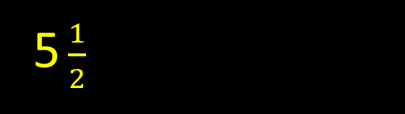

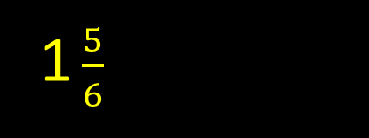

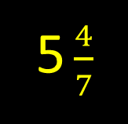
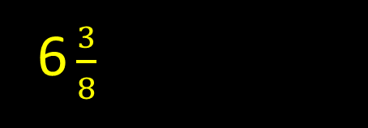
1 $\frac{5}{6}$
75
11/6
5 $\frac{1}{2}$
69
11/2
6 $\frac{3}{8}$
32
51/8
5 $\frac{4}{7}$
38
39/7
12 $\frac{4}{9}$
7
112/9
3 $\frac{4}{5}$
57
19/5
We asked 100 people to change these mixed numbers to improper fractions.

Slide 53
2/3, 3/4, 1/4, 1/10
56
1/10 1/4 2/3 3/4
1/3, 1/4, 2/5, 4/7
18
1/4 1/3 2/5 4/7
1/3, 2/7, 1/4, 3/8
8
1/4 2/7 1/3 3/8
7/8, 4/5, 5/7, 9/10
9
5/7 4/5 7/8 9/10
1/10, 2/15, 3/32, 4/44
6
4/44 3/32 1/10 2/15
5/20, 6/18, 7/14, 8/40
42
8/40 5/20 6/18 7/14
We asked 100 people to order these fractions starting with the smallest.

Slide 54
Fractions of Amounts
Multiplying Fractions
Adding Fractions
Dividing Fractions
Subtracting Fractions
% of Amounts
Fraction & % Calculations

Slide 55
1/4 of 36
70
9
3/5 of £1.20
9
72p
3/4 of 2 litres
55
1.5 litres or 1l 500ml
7/12 of 96
38
56
3/7 of 28
49
12
3/13 of 78
5
18
We asked 100 people to calculate fractions of amounts.

Slide 56




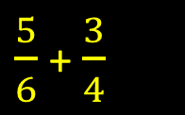
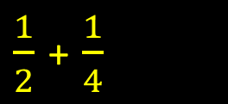

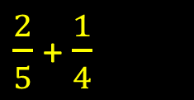




$\frac{1}{2}$ + $\frac{1}{4}$
$$\frac{3}{4}$$
67
$\frac{1}{3}$ + $\frac{1}{4}$
$$\frac{7}{12}$$
17
1 $\frac{1}{5}$ + 2 $\frac{1}{10}$
3 $\frac{3}{10}$
25
$\frac{2}{5}$ + $\frac{1}{4}$
$$\frac{13}{20}$$
13
$\frac{5}{6}$ + $\frac{3}{4}$
1 $\frac{7}{12}$
2
$\frac{1}{5}$ + $\frac{1}{3}$
$$\frac{8}{15}$$
14
We asked 100 people to add these fractions.

Slide 57
3/4 – 1/4
62
1/2
1/3 – 1/4
5
1/12
2/5 – 1/10
18
3/10
1 ¼ - ½
39
3/4
1 1/5 – 1/3
0
13/15
7/8 – 1/3
0
13/24
We asked to convert these decimals to %.

Slide 58
½ x ¼
43
1/8
i
1/5 x 1/6
32
1/30
2/3 x 1/4
0
1/6
2/3 x 2/3
8
4/9
1/7 x 1/8
25
1/56
1/3 x 1/2
35
1/6
We asked 100 people to multiply these fractions giving answers in the simplest form.

Slide 59
1/6 ÷ 3
15
1/18
1/3 ÷ 2
21
1/6
1/2 ÷ 2
36
1/4
2/3 ÷ 3
1
2/9
1/6 ÷ 4
14
1/24
3/7 ÷ 9
9
1/21
We asked 100 people to divide these fractions giving the answer in the simplest form.

Slide 60
25% of 2 litres
29
500ml
5% of 140
18
7
75% of 24
53
18
15% of £2.80
8
£0.42 or 42p
39% of £4
3
£1.56
1% of 8kg
16
80g or 0.08kg
We asked 100 people to calculate the % of these amounts.

Slide 61
Analogue → Digital
How long?
Digital → Analogue
Forward in time
24 Hour Clock
Backwards in time
Time

Slide 62
Five to eight
35
7:55
Twenty-seven minutes past 6
43
6:27
Seventeen minutes to one
14
12:43
Quarter to eleven
42
10:45
Half past three
79
3:30
Three minutes past noon
51
12:03
We asked 100 people to change these analogue times to digital.

Slide 63
7:46
21
14 minutes to eight
10:15
71
Quarter past 10
2:35
42
25 minutes to 3
11.09
75
9 minutes past 11
5:37
13
23 minutes to 6
9:54
25
6 minutes to 10
We asked 100 people to change these digital times to analogue.

Slide 64
2:30am
57
02:30
5:48pm
38
17:48
12:04am
29
00:04
9:47pm
25
21:47
7:15pm
35
19:15
10:18am
76
10:18
We asked 100 people to convert these times to 24 hour clock.

Slide 65
5:40 – 6:25
59
45mins
i
2057 - 0109
7
4hr 12mins
10:15 – 10:50
76
35mins
06:37 – 10:29
9
3hr 52mins
5:48 – 6:14
35
26mins
2:04 – 4:28
37
2hr 24mins
We asked 100 people to work out how long these TV programmes were.

Slide 66
10:17 + 35mins
51
10:52
6:51 + 28mins
33
7:19
8:40 + 90mins
38
10:10
23:48 + 1hr 16mins
9
0104
3:25 + 15mins
79
3:40
2:49 + 6hr 29mins
7
9:18
We asked 100 people to work out when a TV programme finished given its start time and length.

Slide 67
6:15 – 2hr 30mins
44
3:45
3:18 – 46mins
37
2:32
2:45 – 6hrs 57mins
1
7:48
4:22 – 94mins
16
2:48
10:30 – 15mins
87
10:15
8:50 – 1hr 15mins
49
7:35
We asked 100 people to work out when a TV programme started given its length and finish time.

Slide 68
Simplifying Ratios
Cooking
Ratio → Proportion
Spiders:Flies
Proportion → Ratio
Scale drawing
Ratio & Proportion

Slide 69
12:8
79
3:2
38:95
15
2:5
56:42
34
4:3
22:121
48
2:11
36:15
51
12:5
34:51
10
2:3
We asked 100 people to simplify these ratios.

Slide 70
2:7
53
2/9
1:4
62
1/5
3:5:7
7
1/5
3:5
54
3/8
2:3:5
9
1/5
3:7:9
25
3/19
We asked 100 people to change ratios of white:other colours to proportion of white.

Slide 71
4/9
42
4:5
7/15
36
7:8
1/2
39
1:1
1/3
47
1:2
2/9
43
2:7
3/98
29
3:95
We asked to convert these proportion of white to ratios of white:other colours

Slide 72
20 buns
56
80g
i
1 bun
69
4g
100 buns
51
400g
30 buns
47
120g
17 buns
8
68g
500 buns
17
2kg
We asked 100 people to work out how much sugar they needed to make buns if you need 20g for 5 buns.

Slide 73
6 spiders
57
15 flies
45 flies
26
18 spiders
100 flies
33
40 spiders
14 spiders
29
35 flies
56 (total of spiders and flies)
6
16 spiders & 40 flies
400 spiders
11
1000 flies
We asked 100 people to work out how many spiders and/or flies there would be if the ratio of spiders to flies is 2:5

Slide 74
2cm
87
10m
15cm
52
75m
3mm
6
150cm or 1.5m
23cm
21
115m
16cm
27
80m
3.5cm
11
17.5m
We asked 100 people to work out the actual length of a wall from measurements in a scale drawing (1cm = 5m)

Slide 75
→ Roman Numerals 1
Roman Numerals →
→ Roman Numerals 2
Roman Numerals →
Calculations
Calculations
Roman Numerals

Slide 76
10
75
X
1
86
I
15
63
XV
19
21
XIX
53
19
LIII
112
17
CXII
We asked 100 people to write these numbers as Roman Numerals.

Slide 77
LXXXVIII
4
88
IX
70
9
XXVII
29
27
III
89
3
LXXIV
9
74
XLI
18
41
We asked 100 people to write figures for these Roman Numerals.

Slide 78
550
23
DL
1888
3
MDCCCLXXXVIII
2015
26
MMXV
49
15
XLIX
7
87
VII
3988
0
MMMCMLXXXVIII
We asked 100 people to convert these numbers to Roman Numerals.

Slide 79
CMXXIII
9
923
i
XVIII
91
18
CCCDXXII
28
372
MMMDCCXLVIII
0
3748
XCI
21
91
DCCCXCIV
7
894
We asked 100 people to write figures for these Roman Numerals.

Slide 80
V + XIX
62
XXIV
VI X VIII
41
XLVIII
LXXXVI - XXXII
24
LIV
CXXXII ÷ XII
18
XI
CXLII + CCCLXXXIX
1
DXXXI
C X VIII
16
DCCC
We asked 100 people to write the answers to these calculations in Roman Numerals.

Slide 81
DCXLIII + CXXVIII
3
DCCLXXI
CDXC ÷ LXX
17
VII
MMDCCCLXXXVIII - MDXXVII
0
MCCCLXI
LXXI - XLIX
24
XXII
IX + VIII
79
XVII
XII X VIII
37
XCVI
We asked 100 people to write the answers to these calculations in Roman Numerals.

Slide 82
Highest Common Factor
Squares
Lowest Common Multiple
Indices
Factorise
Square Roots
Factors

Slide 83
16, 24
80
8
96, 72
23
24
63, 84
24
21
144, 40
16
8
156, 390
2
78
156, 60
7
12
We asked 100 people to find the highest common factors of these numbers.

Slide 84
4, 3
86
12
6, 8
70
24
15, 20
42
60
12, 20, 15
35
60
78, 182, 130
0
2730
8, 12, 15
18
120
We asked 100 people to find the lowest common multiple of these numbers.

Slide 85
36
42
2 X 2 X 3 X 3
39
33
3 X 13
96
16
2 X 2 X 2 X 2 X 2 X 3
10
84
2 X 5
156
11
13 X 2 X 2 X 3
2310
0
2 X 3 X 5 X 7 X 11
We asked 100 people to factorise these numbers.

Slide 86
13 X 2²
27
52
i
2² X 3²
91
36
5² X 2²
28
100
10³ X 2³
0
8000
3² X 2⁴
21
144
10² X 3²
7
900
We asked 100 people to work out these indices.

Slide 87
22²
2
484
8²
41
64
4²
59
16
2²
79
4
12²
37
144
100²
35
10000
We asked 100 people to write calculate these squares.

Slide 88






$$\sqrt{9}$$
82
3
$$\sqrt{49}$$
43
7
$$\sqrt{121}$$
27
11
$$\sqrt{169}$$
5
13
$$\sqrt{36}$$
49
6
$$\sqrt{256}$$
0
16
We asked 100 people to find the square root of these numbers.

Slide 89
Number Sequences 1
Number Sequences 4
Number Sequences 2
Find the n^{th} term
Number Sequences 3
Find the 15th term
Number Sequences

Slide 90
7 5 3 1
31
-1 -3
1 4 16 25
23
36 49
3 5 8 12
39
17 23
0.1 0.2 0.3 0.4
94
0.5 0.6
37 43 49 55
52
61 67
2 4 8 16
46
32 64
We asked 100 people to find the next two numbers in these sequences.

Slide 91
19 12 6 1
10
-3 -6
2 3 5 7
7
11 13
2.16 2.11 2.06 2.01
23
1.96 1.91
0 1 1 2
2
3 5
26 28 30 32
79
34 36
2 6 18 54
13
312 936
We asked 100 people to find the next two numbers in these sequences.

Slide 92
154 _ _ 205
3
171 188
4 _ 4.1 _ 4.2
29
4.05 4.15
2 _ 16 _ 30
32
9 23
105 _ _ 141
9
117 129
11 _ _ -16
21
2 -7
6 _ _ 15 18
76
9 12
We asked 100 people to fill in the missing numbers in these sequences.

Slide 93
8 11 14 17
26
3n + 5
i
0.5 1 1.5 2
9
0.5n
1 7 13 19
21
6n - 5
2 4 6 8
66
2n
9 7 5 3
6
-2n + 11
4 1 -2 -5
4
-3n + 7
We asked 100 people to work out the n^{th} term in these sequences.

Slide 94
9 5 1 -3
5
-47
3 6 9 12
59
45
0.4 0.7 1.0 1.3
8
4.6
-4 -7 -10 -13
7
-46
21 30 39 48
0
147
10 15 20 25
48
80
We asked 100 people to find the 15th term in these sequences.

Slide 95
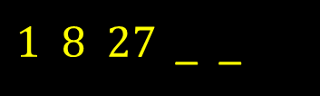
$1 8 27$ _ _
12
64 125
40 20 10 _ _
39
5 2.5
7 _ 23 _ 39
19
15 31
4 8 12 _ _
79
16 20
0.125 0.25 _ 0.5 _
7
0.375 0.625
3.5 1 _ -4 _
9
-1.5 -6.5
We asked 100 people to find the missing number in these sequences.

Slide 96
Find x (1)
Finding values 1
Find x (2)
Finding values 2
Find x (3)
2 variables
Algebra

Slide 97
x + 1 = 2
75
x = 1
x – 4 = 6
52
x = 10
3 + x = 8
55
x = 5
-4 + x = 8
21
x = 12
21 – x = 6
39
x = 15
3 + x -2 = 5
40
x = 4
We asked 100 people to find the value of x.

Slide 98
2x = 4
83
x = 2
3x = 51
19
x = 17
9x = 81
43
x = 9
6x = 24
64
x = 4
5x = 75
28
x = 15
8x = 48
52
x = 6
We asked 100 people to find the value of x.

Slide 99

2x + 2 = 4
69
x = 1
6x + 5 = 23
29
x = 3
10x – 7 = 83
33
x = 9
3x – 6 = 6
31
x = 4
7x – 5 = 51
25
x = 8
$$\frac{x}{3}=12$$
x = 36
15
We asked 100 people to find the value of x.

Slide 100
-3x – 5 x = 3
12
-14
i
17x + 8 x = 4
8
76
6x x = 8
64
48
3x + 7 x = 6
41
25
19 – 5x x = 6
22
-11
x + 3 x = 2
81
5
We asked 100 people to work out the value of a formula given x.

Slide 101
4x – 8y x = 7, y = 3
42
4
6x + 3y x = 0.5, y = 14
13
45
5y – 2x x = 9, y = 3
27
-3
8x + 7y x = 9, y = 7
32
121
x + 2y x = 6, y = 8
81
22
3x + 5y x = 19, y = 16
5
137
We asked 100 people to work out the value of a formula given x and y.

Slide 102
2y – x = 7 17 > x > 11
8
x=13, y=10 or x=15, y=11
3y X 6x = 72 x > y
4
x=4, y=1
4x X 2y = 48 y < 5, x > y
19
x=6, y=1 or x=3, y=2
3x + 4y = 20
13
x=4, y=2
x + y = 10 x > 7, y > 0
78
x=8, y=2 or x=9, y=1
5x + 6y = 40
12
x=2, y=5
We asked 100 people to find possible values for x and y – positive whole numbers only.

Slide 103
Rounding to nearest 10
Rounding to nearest 1
Rounding to nearest 100
Round up
Rounding to nearest 1000
Round down
Rounding

Slide 104
59
75
60
125
47
130
73
85
70
495
40
500
4
28
0
340
62
340
We asked 100 people to round these numbers to the nearest 10.

Slide 105
51
61
100
2929
45
2900
975
39
1000
349
82
300
1250
42
1300
460
79
500
We asked 100 people to round these numbers to the nearest 100.

Slide 106
489
58
0
4500
69
5000
29500
61
30000
154687
49
155000
299499
41
299000
14321
78
14000
We asked 100 people to round these numbers to the nearest 1000.

Slide 107
9.5
67
10
i
5.18
69
5
0.499999
47
0
6.7
76
7
15.489
43
15
19.50001
52
20
We asked 100 people to round these numbers to the nearest whole number.

Slide 108
67
85
70
54
58
60
21
53
30
642
48
650
991
41
1000
23.42
45
30
We asked 100 people to round these numbers up to nearest 10.

Slide 109
4859361
40
4859000
998
37
0
15951
48
15000
5864
63
5000
7952
59
7000
5124
76
5000
We asked 100 people to round these numbers down to the nearest 1000.

Slide 110
Mean
Range
Median
Identifying Charts
Mode
Tally Chart/ Frequency
Data Handling

Slide 111
18, 16, 15, 19, 7
67
15
1.2, 2.3, 3.4, 1.5, 1.8
6
2.04
20, 16, 23, 19, 17
61
19
-7, 6, -3, -10, 4
22
-2
2, 3, 10, 5
82
5
550, 1600, 950, 800, 400
2
860
We asked 100 people to find the mean of these numbers.

Slide 112
17, 26, 9, 4, 18
76
17
9.09, 9, 0.999, 19.19, 8.99
23
9
251, 317, 95, 76, 108
55
108
95, 41, 25, 37, 81, 101, 65
34
65
41, 59, 87, 60, 94, 38
0
59.5
460, 580, 973, 428, 647
41
580
We asked 100 people to find the median of these numbers.

Slide 113
6, 9, 7, 8, 7, 5
75
7
21, 25, 24, 25, 26, 21, 21
26
21
1.8, 1.5, 1.9, 1.8, 1.6
32
1.8
512, 623, 410, 623, 522,
36
623
0.5, 0.7, 0.9, 0.8, 0.4, 0.9
28
0.9
234, 423, 324, 432, 342, 234
22
234
We asked 100 people to find the mode of these numbers.

Slide 114
21.5, 48.6, 72.9, 80.1
24
58.6
i
-7, 2, 14, -5, 11
16
21
75, 92, 68, 145, 67
42
78
15, 24, 32, 25, 28, 17
58
17
6, 7, 8, 2, 12
76
10
2001, 780, 598, 14
9
1987
We asked 100 people to find the range of these numbers.

Slide 115
Bar Chart
12
14
Venn Diagram
Line Graph
7
2
A
72
B
50
C
42
Pork
Custard
Pie Chart
Pictogram
Carroll Diagram
spiders
flies
Steak & Kidney
Apple
octopus
flying fish
Cottage
D
67
E
35
F
22
We asked 100 people to identify these charts.

Slide 116
llll llll llll llll llll llll llll llll llll llll
29
49
llll lll
73
8
llll llll llll ll
59
17
lll
87
3
llll llll llll llll llll lll
43
28
llll llll llll llll llll llll llll llll l
37
41
We asked 100 people to find the frequency from these tally scores.

Slide 117
Perimeter
Finding missing side
Area
Area
Volume
Area – Compound shapes
Area, Perimeter & Volume

Slide 118
Rectangle (4cm x 7cm)
76
22cm
Rectangle (19km x 13km)
41
64km
Square with side 7mm
48
28mm
Rectangle (15m x 12m)
59
54m
Regular hexagon (side 13m)
32
78m
Equilateral triangle (side 4m)
43
12m
We asked 100 people to find the perimeter of these shapes.

Slide 119
Rectangle (13cm x 8cm)
23
104cm²
Square with side 11m
45
121m²
Rectangle (4cm x 8cm)
72
32cm²
Square with side 100m
29
10000m²
Rectangle (12km x 15km)
21
180m²
Rectangle (3m x 4m)
83
12m²
We asked 100 people to find the area of these shapes.

Slide 120
Cuboid (3cm x 2m x 5cm)
0
3000cm³
Cube with edge 3cm
46
27cm³
Cuboid (4m x 6m x 5m)
53
120m³
Cuboid (2cm x 3cm x 6cm)
72
36cm³
Cuboid (7mm x 6mm x 5mm)
45
210mm³
Cube (area of 1 face =25cm²)
13
125cm³
We asked 100 people to find the volume of these shapes.

Slide 121
Square of area 81cm²
53
9cm
i
Rectangle – area 36m², side 4m.
77
9m
Cube of volume 64m³
29
4m
Cuboid – volume 144m³, sides 8m, 2m
5
9m
Rectangle – area 15m², side 2m
38
7.5m
Rectangle – area 111cm², side 3cm
9
37cm
We asked 100 people to find the length of the missing side.

Slide 122
3 x 4 x ½ =6cm²
5cm
6 x 3 x ½ =9cm²
7 x 7 x ½ = 24.5 cm²
3cm
7cm
7cm
6cm
4cm
3cm
7cm
A
64
B
39
C
45
8cm
6 x 3 =
18 cm²
8 x 4 =
32 cm²
7 x 3 =
21 cm²
3.5
cm
3cm
3.5
cm
3cm
4cm
4.5
cm
6cm
7cm
D
38
E
37
F
36
We asked 100 people to find the area of these shapes. cm²

Slide 123
7cm
4 x 10= 40
3 x 4 = 12
=52cm²
2 x 7 = 14
4 x 7 = 28
=42cm²
5 x 4=20
3 x 8=24
=44cm²
2cm
8cm
5cm
10cm
7cm
7cm
4cm
6cm
8cm
4cm
4cm
A
48
B
42
C
53
2 x 4.5=9
1 x 1.5=1.5
8 x 2.5=20
=30.5 cm²
9 x 3 =27
2 x 3 x ½=3
=30cm²
16 x 7 = 112
3 x 12 = 36
112-36=76cm²
4.5cm
3cm
2cm
7cm
12cm
7cm
5cm
6cm
8cm
3cm
1cm
1.5cm
16cm
4cm
9cm
D
12
E
0
F
3
We asked 100 people to find the area of these shapes.

Slide 124
Symmetry 1
Symmetry of letters
Symmetry 2
Nets for 3D shapes 1
Symmetry 3
Nets for 3D shapes 2
Symmetry & Nets for 3D shapes

Slide 125
1
4
3
A
72
B
23
C
31
0
2
1
D
42
E
69
F
35
We asked 100 people how many lines of symmetry each shape has.

Slide 126
1
2
2
A
75
B
33
C
39
2
1
4
D
40
E
73
F
19
We asked 100 people how many lines of symmetry each shape has.

Slide 127
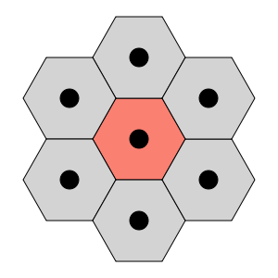
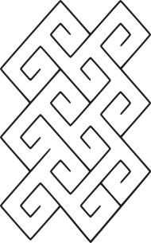
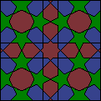
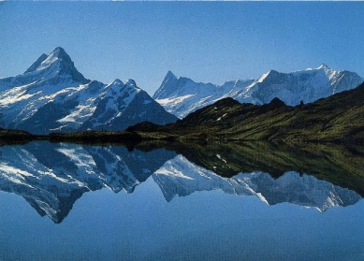


2
0
6
6
A
49
B
38
C
4
0
1
0
D
39
E
37
F
26
We asked 100 people how many lines of symmetry each shape has.

Slide 128
A B C D
A C D
22
E F G H I
E
15
J K L M N
K M
45
O P Q R
38
none
S T U V
T U V
59
W X Y Z
W Y
48
We asked 100 people to name the capital letter(s) in each row with just one line of symmetry.

Slide 129
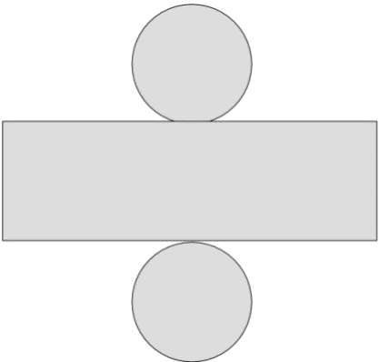
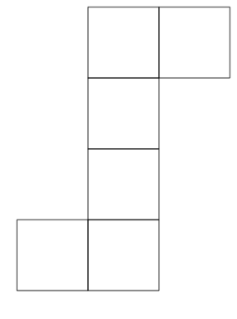
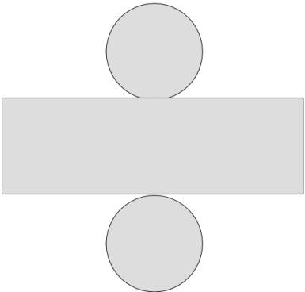
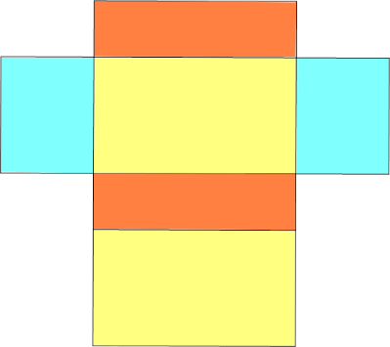
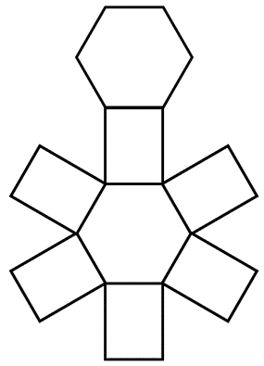
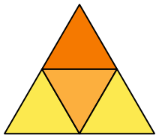
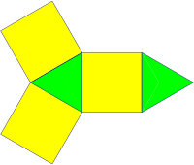
cube
cylinder
cuboid
A
48
B
83
C
61
tetrahedron
Hexagonal prism
Triangular prism
D
19
E
11
F
3
We asked 100 people how many lines of symmetry each shape has.

Slide 130
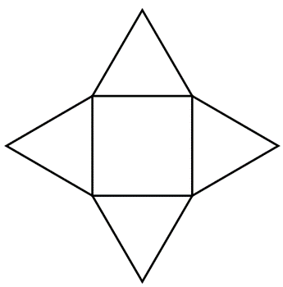
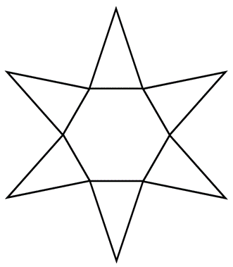
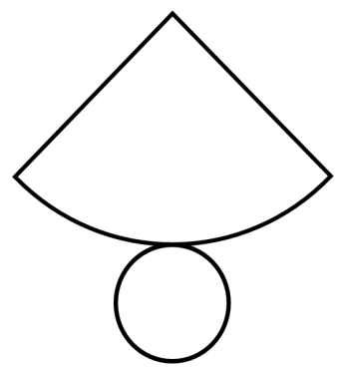
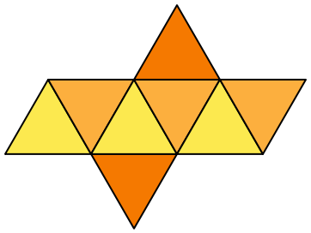
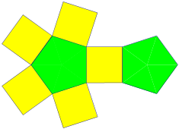

Square based pyramid
Hexagonal based pyramid
cone
A
69
B
24
C
63
Octagonal based pyramid
pentagonal prism
octahedron
D
0
E
14
F
2
We asked 100 people to identify the 3D shapes from the nets.

Slide 131
Change from £5
Find sale price
Change from £10
Find % off
Change from £20
Find original price
Money

Slide 132
£4.11
34
£0.89 or 89p
£1.33
24
£3.67
£2.57
38
£2.43
£3.48
37
£1.52
70p
74
£4.30
£1.60
62
£3.40
We asked 100 people to work out how much change they would get from £5.

Slide 133
£3.99
62
£6.01
£2.57
26
£7.43
£6.18
24
£3.82
£5.55
37
£4.45
£8.34
29
£1.66
£4
98
£6
We asked 100 people to work out how much change they would get from £10.

Slide 134
£7.41
37
£12.59
£16.27
31
£3.73
£12.91
34
£7.09
£9.34
43
£10.66
£2.50
74
£17.50
£6.99
53
£13.01
We asked 100 people to work out how much change they would get from £20.

Slide 135
£80 – 5% off
51
£76
i
£75 – 20% off
59
£60
£36 – 17% off
0
£29.88
£40 – 50% off
89
£20
£35.40 – 10% off
13
£31.86
£60 – 15% off
34
£51
We asked 100 people to find the sale price of these items.

Slide 136
Was £75 Now £63.75
3
15%
Was £72 Now £48
43
33%
Was £16 Now £14.40
39
10%
Was £1000 Now £950
52
5%
Was £60 Now £30
84
50%
Was £9.60 Now £8.40
19
12.5%
We asked 100 people to work out the % off as the prices were reduced.

Slide 137
5% off – Sale price £57
43
£60
10% off – Sale price £72
51
£80
25% off – Sale price £108
18
£144
20% off – Sale price 80p
67
£1
40% off – Sale price £99
14
£165
37.5% off – Sale price £3.50
0
£5.60
We asked 100 people to find the original price from the sale price and the % off.

Slide 138
Value of a digit 1
Making smallest number
Value of a digit 2
x by 10, 100 etc
Ordering numbers
÷ by 10, 100 etc
Place Value

Slide 139
69,342
58
three hundred
9,531,754.29
32
thirty thousand
31,248,596
10
thirty million
2564.23
19
three hundredths
954,324,578.6
21
three hundred thousand
732
89
thirty
We asked 100 people the value of 3 in each of these numbers.

Slide 140
6942.5
62
six thousand
5.06
21
six hundredths
3954.256
3
six thousandths
975.625
39
six tenths
986,248,321.2
22
six million
4296.1
86
six
We asked 100 people the value of the digit 6.

Slide 141
9.01, 9.19, 9.91, 9
26
9, 9.01, 9.19, 9.91
754, 745, 747, 774
59
745, 747, 754, 774
.09, 0.90, 0.1, 0.19
25
0.09, 0.1, 0.19, 0.9
11010, 10110, 11100, 10101
21
10101, 10110, 11010, 11100
123, 213, 321, 312, 231
32
123, 213, 231, 312, 321
123012, 123021, 12392.1
19
12392.1, 123012, 123021
We asked 100 people to order these sets of numbers starting with the smallest number.

Slide 142
68162
45
12668
31872
43
12378
21814
34
11248
981
86
189
158851
29
115588
24182
35
12248
We asked 100 people to rearrange these digits to give the smallest number.

Slide 143
62 x 10
83
620
i
2.16054 x 10000
2
21605.4
25.6 x 10
49
256
.037 x 1000
09
37
28.03 x 10
41
280.3
2.356 x 100
24
235.6
We asked 100 people to work out these multiplication calculations.

Slide 144
25.09 ÷ 1000
3
0.02509
÷
6 ÷ 10
50
0.6
951.3 ÷ 100
17
9.513
150 ÷ 10
84
15
2658 ÷ 100
23
26.58
312.68 ÷ 100
10
3.1268
We asked 100 people to work out these division calculations.

Slide 145
Co-ordinates shapes
Compass points 1
Co-ordinates: reflection 1
Compass points 2
Co-ordinates : reflection 2
Compass points 3
Co-ordinates & Compass points

Slide 146
(2,2) (2,3) (3,2)
51
right angled triangle
(2,5) (4,5) (4,3) (2,3)
62
square
(4,1) (4,2) (7,2) (7,1)
53
rectangle
(6,1) (7,4) (8,1)
31
isosceles triangle
(5,2) (6,3) (9,3) (8,2)
14
parallelogram
(2,2) (0,6) (2,8) (4,6)
7
kite
We asked 100 people to identify the shapes from the
co-ordinates.

Slide 147
(2,2)
68
(-2,2)
(1,6)
47
(-1,6)
(6,1)
45
(-6,1)
(-5,4)
9
(5,4)
(7,-6)
17
(-7,-6)
(-10,-14)
5
(10,-14)
We asked 100 people to reflect these co-ordinates through the y axis and give the new co-ordinate.

Slide 148
(-9,-7)
19
(-9,7)
(8,0)
8
(8,0)
(-7,8)
27
(-7,-8)
(4,5)
70
(4,-5)
(6,-3)
25
(6,3)
(-3,-3)
17
(-3,3)
We asked 100 people to reflect these co-ordinates through the x axis and give the new co-ordinate.

Slide 149
SW
56
NE
S
92
N
NE
49
SW
NW
52
SE
SE
47
NW
E
84
W
We asked 100 people to turn 180° from each of these compass points and name the direction they are now facing.

Slide 150
NW – ¾ turn clockwise
21
SW
i
N – ¼ turn clockwise
87
E
SW – ¼ turn anti-clockwise
29
SE
E – ¾ turn anti-clockwise
47
S
SE – ¼ turn clockwise
41
SW
NE – ½ turn anti-clockwise
36
SW
We asked 100 people to give the new direction after a turn.

Slide 151
E – turn 315° clockwise
6
NE
÷
SE – turn 45° anti-clockwise
48
E
NW – turn 270° anti-clockwise
21
NE
N – turn 180° clockwise
74
S
SW – turn 225° clockwise
16
E
S – turn 135° clockwise
11
NW
We asked 100 people to give the new direction after a turn.

Slide 152
Temperature change 1
Bank account change 1
Temperature difference
Bank account difference
Temperature change 2
Bank account change 2
Negative Numbers

Slide 153
5°C rise 7°
83
12°C
6°C drop 10°
48
-4°C
-8°C rise 15°
39
7°C
-2°C drop 13°
28
-15°C
7°C drop 14°
42
-7°C
-7°C drop 14°
25
-21°C
We asked 100 people what the new temperature is.

Slide 154
start 7°C, finish -8°C
38
drop 15°
start -9°C, finish -6°C
31
rise 3°
start 12°C, finish -3°C
37
drop 15°
start -3°C, finish -19°C
32
drop 16°
start -1°C, finish 1°C
69
rise 2°
start 1°C, finish -1°C
65
drop 2°
We asked 100 people to find the drop or rise in temperature.

Slide 155
9°C rise 4° then fall 11°
69
2°C
-5°C fall 6° then fall 4°
46
-15°C
3°C fall 5° then rise 11°
51
9°C
6°C fall 19° then rise 8°
24
-5°C
-7°C rise 2° then rise 3°
36
-2°C
-19°C rise 13° then fall 9°
7
-15°C
We asked 100 people what the new temperature is.

Slide 156
Start £40.50 spend £60
14
-£19.50
Start -£14 receive £40
24
£28
Start -£12 receive £21
41
£9
Start £5.50 spend 11.75
5
-£6.25
Start £15 spend £28
56
-£13
Start £7 receive £19
86
£26
We asked 100 people to give the new balance of a bank account after spending or receiving money.

Slide 157
Start £50 finish -£20
68
Spent £70
i
start £-£47.50 finish £12
25
Received £59.50
Start £38 finish -£25.40
27
Spent £63.40
Start -£10 finish £10
81
Received £20
Start £106.34 finish -£45.23
7
Spent £151.57
Start -£45 finish -£97.30
19
Spent £52.30
We asked 100 people to find the amount spent or received from these bank accounts.

Slide 158
Start £25, spend £13, receive £7
79
£19
÷
Start -£14, spend £4, spend £6.50
31
-£24.50
Start £87.20, spend £100, receive £19.50
4
£6.70
Start -£200, spend £50, receive £150
48
-£100
Start £25, receive £12, receive £13.50
56
£50.50
Start -£64, spend £14, receive £16.30
17
-£61.70
We asked 100 people to give the new balance of a bank account after spending and/or receiving money.

Slide 159
Using 4 threes
What number?
Using 4 fours
How many coins?
Dimensions of cuboids
What age?
Puzzles

Slide 160
6
69
3+3+3-3
9
55
3 x 3 +3 – 3 or (3+3-3) x 3
3
28
(3+3+3)/3
7
19
3+3 + 3/3
5
17
3+3 – 3/3
2
3
3/3 + 3/3
We asked 100 people to make these numbers using 4 (no more, no less) threes and any Maths signs. 3 3 3 3

Slide 161
0
66
44-44 or 4+4-4-4
8
43
4 + 4 + 4 - 4
20
2
4 x (4/4 + 4)
1
32
44/44 or 4+4/4+4
9
17
4/4 + 4 + 4
3
28
(4+4+4)/4
We asked 100 people to make these numbers using 4 (no more, no less) fours and any Maths signs. 4 4 4 4

Slide 162
385cm³
8
5cm x 7cm x 11cm
4199cm³
0
13cm x 17cm x 19cm
30cm³
72
2cm x 3cm x 5cm
1001cm³
4
7cm x 11cm x 13cm
105cm³
23
3cm x 5cm x 7cm
2431cm³
0
11cm x 13cm x 17cm
We asked 100 people to find the l x w x h of these cuboids. All the sides are whole numbers > 1.

Slide 163
Multiple of 12; multiple of 8; sum of its 2 digits=9
72
17
<100; multiple of 7; sum of digits=11
i
23
56
Square number; <200; 3 digits; product of digits=54
0
169
Square number; odd; <50; sum of its digits=13
43
49
Prime number; <50; product of digits =21
19
37
Multiple of 10; >40; <60
76
50
We asked 100 people to find the number from the clues.

Slide 164
£2.49
23
£2, 20p, 20p 5p, 2p, 2p (6)
i
98p
26
50p, 20p, 20p, 5p, 2p, 1p (6)
43p
72
20p, 20p, 2p, 1p (4)
35p
90
20p, 10p, 5p (3)
£1.64
54
£1, 50p, 10p, 2p, 2p (5)
£3.89
6
£2, £1, 50p, 20p, 10p, 5p, 2p, 2p (8)
We asked 100 people to find the least number of UK coins needed to make each of these amounts.

Slide 165
I am 3 years older than Sam who was 12 five years ago.
54
20
I am 7 years younger than Jane who will be 32 in 2 years time.
45
23
In 3 years I will be twice as old as Sarah who was 17 last year.
2
39
I am 3 years older than Jim who is 5 years younger than Anne (20).
76
18
In 2 years time I will be twice as old as James. He is 33 now.
3
68
My age is midway between Henry (38) and Georgia (12).
26
13
We asked 100 people to find the ages from the clues.

Slide 166

100

Slide 167
99

Slide 168
98

Slide 169
97

Slide 170
96

Slide 171
95

Slide 172
94

Slide 173
93

Slide 174
92

Slide 175
91

Slide 176
90

Slide 177
89

Slide 178
88

Slide 179
87

Slide 180
86

Slide 181
85

Slide 182
84

Slide 183
83

Slide 184
82

Slide 185
81

Slide 186
80

Slide 187
79

Slide 188
78

Slide 189
77

Slide 190
76

Slide 191
75

Slide 192
74

Slide 193
73

Slide 194
72

Slide 195
71

Slide 196
70

Slide 197
69

Slide 198
68

Slide 199
67

Slide 200
66

Slide 201
65

Slide 202
64

Slide 203
63

Slide 204
62

Slide 205
61

Slide 206
60

Slide 207
59

Slide 208
58

Slide 209
57

Slide 210
56

Slide 211
55

Slide 212
54

Slide 213
53

Slide 214
52

Slide 215
51

Slide 216
50

Slide 217
49

Slide 218
48

Slide 219
47

Slide 220
46

Slide 221
45

Slide 222
44

Slide 223
43

Slide 224
42

Slide 225
41

Slide 226
40

Slide 227
39

Slide 228
38

Slide 229
37

Slide 230
36

Slide 231
35

Slide 232
34

Slide 233
33

Slide 234
32

Slide 235
31

Slide 236
30

Slide 237
29

Slide 238
28

Slide 239
27

Slide 240
26

Slide 241
25

Slide 242
24

Slide 243
23

Slide 244
22

Slide 245
21

Slide 246
20

Slide 247
19

Slide 248
18

Slide 249
17

Slide 250
16

Slide 251
15

Slide 252
14

Slide 253
13

Slide 254
12

Slide 255
11

Slide 256
10

Slide 257
9

Slide 258
8

Slide 259
7

Slide 260
6

Slide 261
5

Slide 262
4

Slide 263
3

Slide 264
2

Slide 265
1

Slide 266
Pointless

Slide 267
x

Slide 268
100

Slide 269
99

Slide 270
98

Slide 271
97

Slide 272
96

Slide 273
95

Slide 274
94

Slide 275
93

Slide 276
92

Slide 277
91

Slide 278
90

Slide 279
89

Slide 280
88

Slide 281
87

Slide 282
86

Slide 283
85

Slide 284
84

Slide 285
83

Slide 286
82

Slide 287
81

Slide 288
80

Slide 289
79

Slide 290
78

Slide 291
77

Slide 292
76

Slide 293
75

Slide 294
74

Slide 295
73

Slide 296
72

Slide 297
71

Slide 298
70

Slide 299
69

Slide 300
68

Slide 301
67

Slide 302
66

Slide 303
65

Slide 304
64

Slide 305
63

Slide 306
62

Slide 307
61

Slide 308
60

Slide 309
59

Slide 310
58

Slide 311
57

Slide 312
56

Slide 313
55

Slide 314
54

Slide 315
53

Slide 316
52

Slide 317
51

Slide 318
50

Slide 319
49

Slide 320
48

Slide 321
47

Slide 322
46

Slide 323
45

Slide 324
44

Slide 325
43

Slide 326
42

Slide 327
41

Slide 328
40

Slide 329
39

Slide 330
38

Slide 331
37

Slide 332
36

Slide 333
35

Slide 334
34

Slide 335
33

Slide 336
32

Slide 337
31

Slide 338
30

Slide 339
29

Slide 340
28

Slide 341
27

Slide 342
26

Slide 343
25

Slide 344
24

Slide 345
23

Slide 346
22

Slide 347
21

Slide 348
20

Slide 349
19

Slide 350
18

Slide 351
17

Slide 352
16

Slide 353
15

Slide 354
14

Slide 355
13

Slide 356
12

Slide 357
11

Slide 358
10

Slide 359
9

Slide 360
8

Slide 361
7

Slide 362
6

Slide 363
5

Slide 364
4

Slide 365
3

Slide 366
2

Slide 367
1

Slide 368
Pointless

Slide 369
Thank you for playing Pointless Maths

